Slide 1


WSDM - KKBox’s Music Recommendation Challenge
Project 3 McNulty
Ferdinand Wohlenberg
August 7, 2019

Slide 2

Market Intro - Fast Growth & High Competition
Facts:
Americans spend 4 hours a day listening to music
1.2 trillion songs streamed on demand (2018)
US Music Streaming market size: $11.1 bn (2019)
Objective:
Determining user-specific music preferences
Recommending suitable songs
Notes:
The music industry has been growing steadily over the past years.
Americans spend 4 hours a day listening to music
1.2 trillion songs were streamed on demand in 2018
Resulting in a total market size of 11.1 bn in 2019
So the competition on the streaming market is very high and companies try to gain ac ompetitive advantage through their recommendation system
Therefore objective of companies:
Finding patterns in user-specific music preferences
Recommending suitable songs in order to attract customers through good recommendations
Source: https://www.riaa.com/facts/

Slide 3
Methodology
Lorem 1
Data Wrangling
Data:
Datasets: kaggle.com (KKbox)
> 7 MM Entries
Preparing Data
Merging Dataframes
Tools:
AWS EC2 Instance
Notes:
I dont want to spend too much time here, just a quick overview of how I tackled the problem.
I started by downloading the data to my aws ec2 instance and prepared and merged the dataframes into one to start the modelling process

Slide 4
Methodology
Lorem 2
Lorem 1
Modelling
Data Wrangling
Data:
Datasets: kaggle.com (KKbox)
> 7 MM Entries
Preparing Data
Merging Dataframes
Tools:
AWS EC2 Instance
Process:
Baselining
Feature Engineering
Hyperparameter Tuning
Models:
Logistic Regression
KNN
Random Forest
Light GBM
Metric: AUC Score
Notes:
started to create a baseline
incrementally improved the model through feature engineering.
Finally had to engage in Hyperparameter Tuning to find the optimal setup.
Models:Logistc Regression, KNN and especially Light GBM for the later model.
As a metric I chose the AUC score, as this can be considered a probability ranking problem.
-> Want to recommend the songs with highest probabilitiy to esnure right fit
- AUC will give me the probability of a random positive song being higher ranked than a random negative
-how well a parameter can distinguish between two diagnostic groups (diseased/normal).
Sensitivity vs. Specificity
The area under the ROC curve (AUC) is a measure of how well a parameter can distinguish between two diagnostic groups (diseased/normal).

Slide 5

Methodology
Lorem 2
Modelling
Lorem 3
Lorem 1
Predictions
Data Wrangling
Data:
Datasets: kaggle.com (KKbox)
> 7 MM Entries
Preparing Data
Merging Dataframes
Tools:
AWS EC2 Instance
Process:
Baselining
Feature Engineering
Hyperparameter Tuning
Models:
Logistic Regression
KNN
Random Forest
Light GBM
Metric: AUC Score
Will user listen to recommended song again over the next 4 weeks ?
Notes:
In the end, the model will predict whether a user will listen to a recommended song again over the next 4 weeks or not!
As a metric I chose the AUC score, as I mostly care about precision (predicting the right songs) and AUC will give me the probability of a random positive song being higher ranked than a random negative

Slide 6
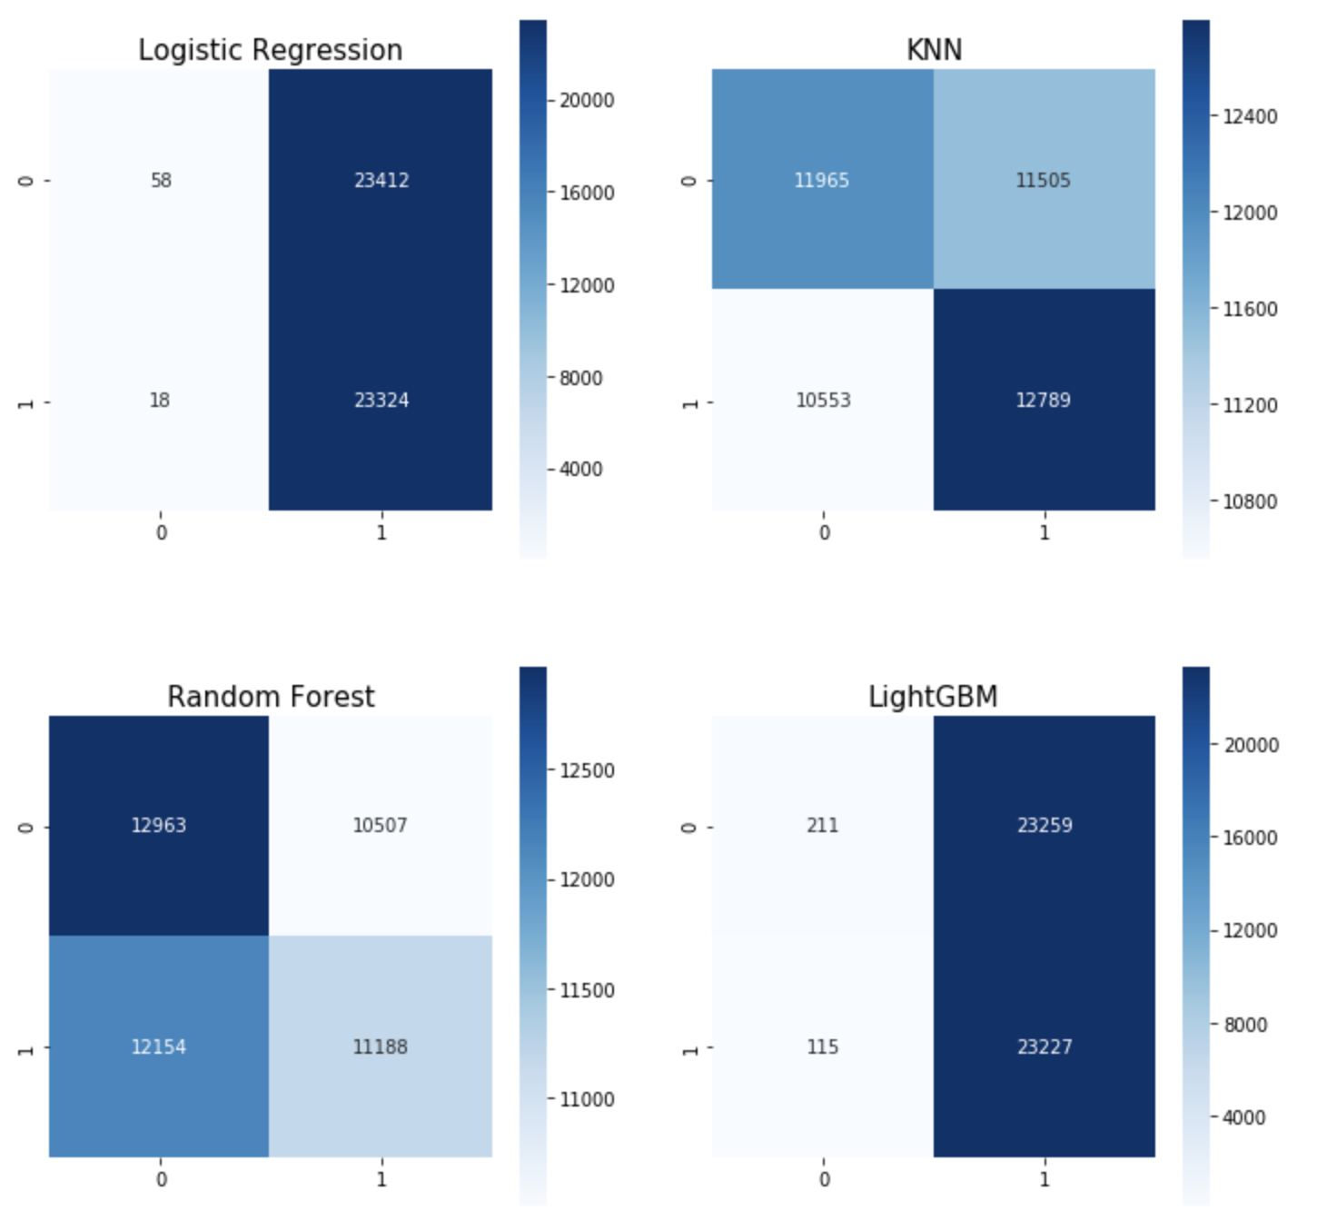
Baseline - No Predictive Power
Features: City, Age, Way of Registration, Song Length
Logistic Regression
AUC Validation Score: 0.5
KNN (5-NN)
AUC Validation Score: 0.53
Notes:
For baseline, I used City, Age, Way of Registration, Song Length
Fitted a Logistic Regregssino and 5-Nearest MNeighbors
But looking at the baseline, it doesn’t have any predictive power
Logistic Regression: Predicts almost entirely positive
KNN: About as many Correct predictions as incorrect predictions
As a metric I chose the AUC score, as this can be considered a probability ranking problem.
-> Want to recommend the songs with highest probabilitiy to esnure right fit
- AUC will give me the probability of a random positive song being higher ranked than a random negative
Sensitivity vs. Specificity
The area under the ROC curve (AUC) is a measure of how well a parameter can distinguish between two diagnostic groups (diseased/normal).

Slide 7
Feature Engineering - > 20 New Features
01
Active Timeframe
Average song length
No. of times listened to artist
Probability of using certain source
User
02
Year
Longer / Shorter than user’s average
Featured (yes/no)
Song
03
No. of times song played
Artist / Lyricist / Composer Popularity
Usage of sources
Popularity
Notes:
I then created more than 20 new features over 3 categories:
User:
Active Timeframe
Average song length
No. of times listed to artist
Probability of using certain source
Song
Year
Longer/shorter than user’s average songs
Features (yes/no)
Popularity
Song popularity
Artist / lyricist / composer popularity
Usage of sources

Slide 8
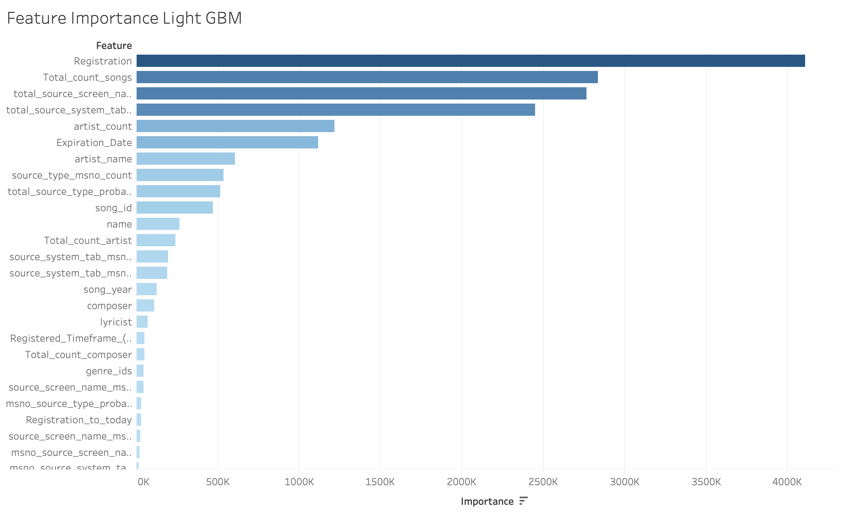
Model - Feature Importance (Gain)
Top 3:
Registration
Song Popularity
Source Usage
Notes:
After feature engineering looking at feature importance
ranking of the importance of features, especially how much predictive power they add to the model.
The most important ones were, Registration Date, Song Popularity and Source Usage

Slide 9
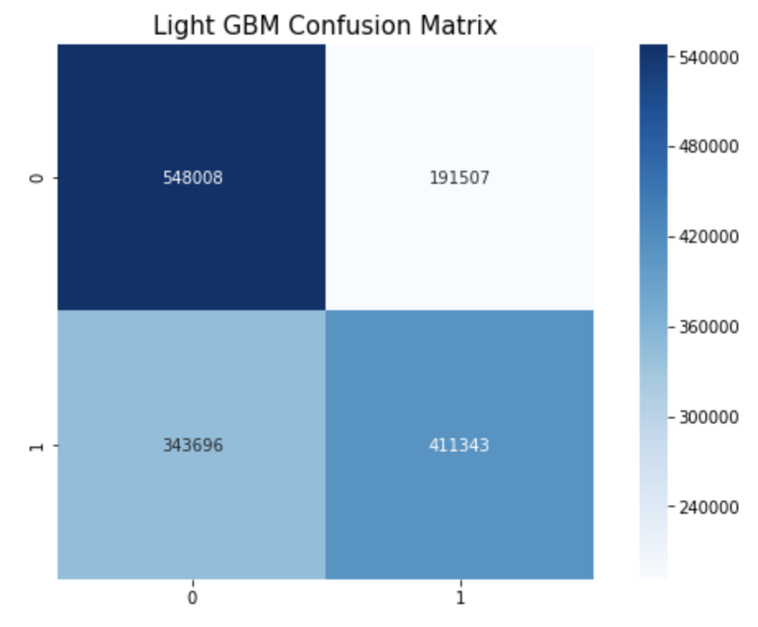



Model - Metric Scores
Final Model: Light GBM (Tree-based)
AUC Validation Score: 0.71
Probability Threshold = 0.58
Precision: 0.68
Recall: 0.55
Accuracy: 0.64
F1: 0.61
Notes:
In the end, the best model resulted in using Light GBM, a
Gradient boosting framework that makes use of tree based learning algorithms
The model’s AUC score was 0.71
Implies theres a 70% chance that a randomly picked positive example is higher ranked than randomly sampled negative example
Dont need interpretation therefore, Light GBM adequate choice
At the bottom are 4 metrics displayed (Precision, Recall, Accuracy, and F1 score)
Heavy weight on precision, therefore higher probability threshold
Confusion matrix on the right imporved significantly from baseline

Slide 10
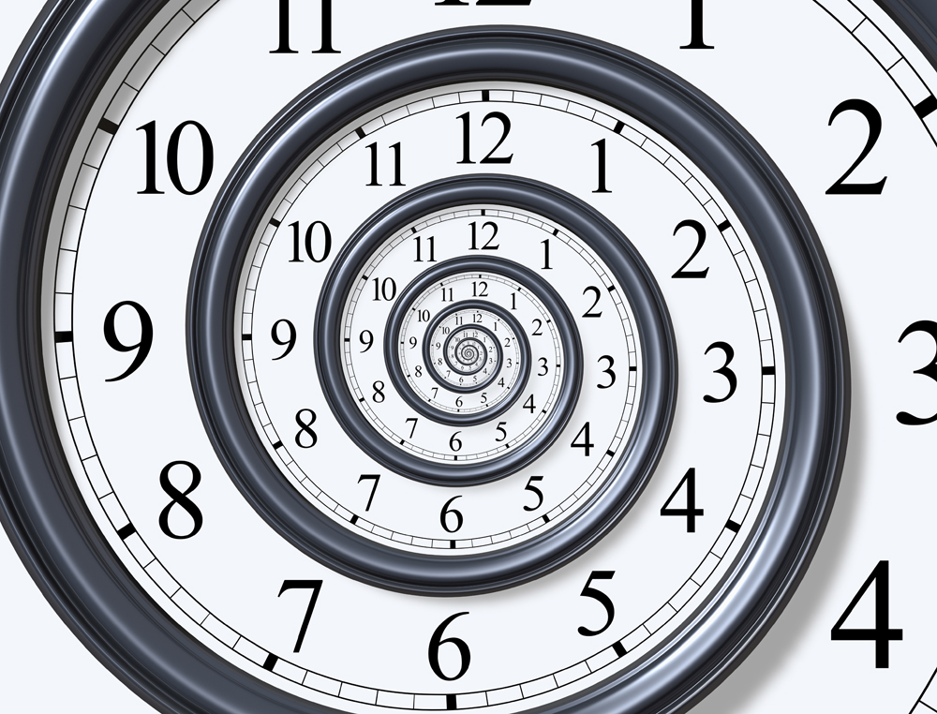
Future Considerations
Adding a timestamp to each entry
Previous / following songs
Previous / following artist
Adding a holdout set for testing purposes
More features
Notes:
For the future, I’d like to add a timestamp to be able to analyze previous and foollowing songs and artist
I did the hyperparameter tuning on the validation set, which kind of falsify my results. So for the future, I’ll create a holdout set for testing puproses
Adding more features

Slide 11


Slide 12
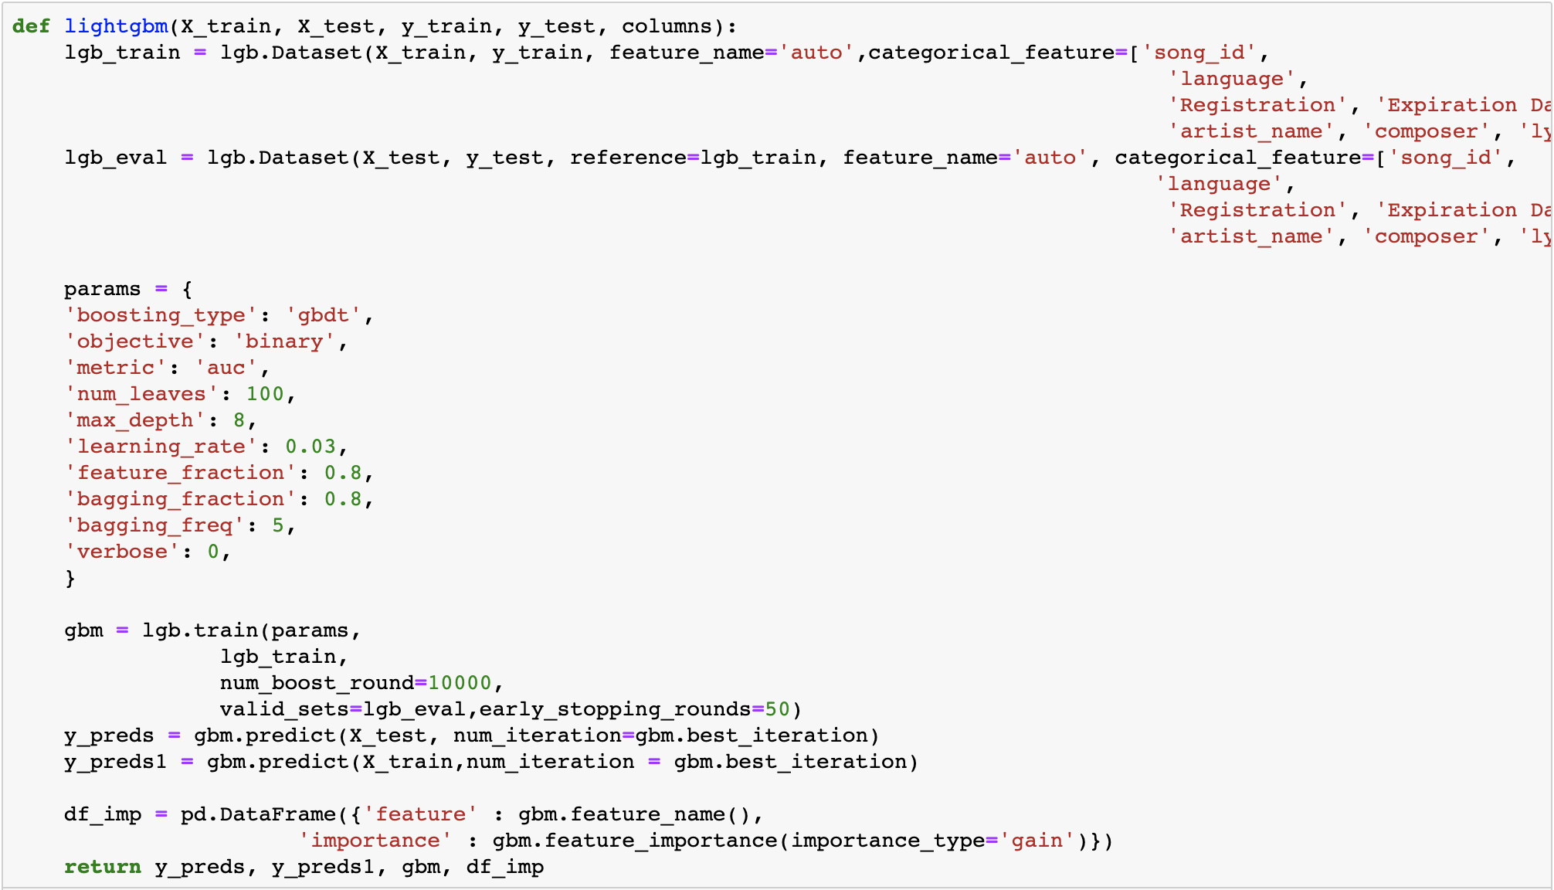
Appendix - Light GBM Model

Slide 13
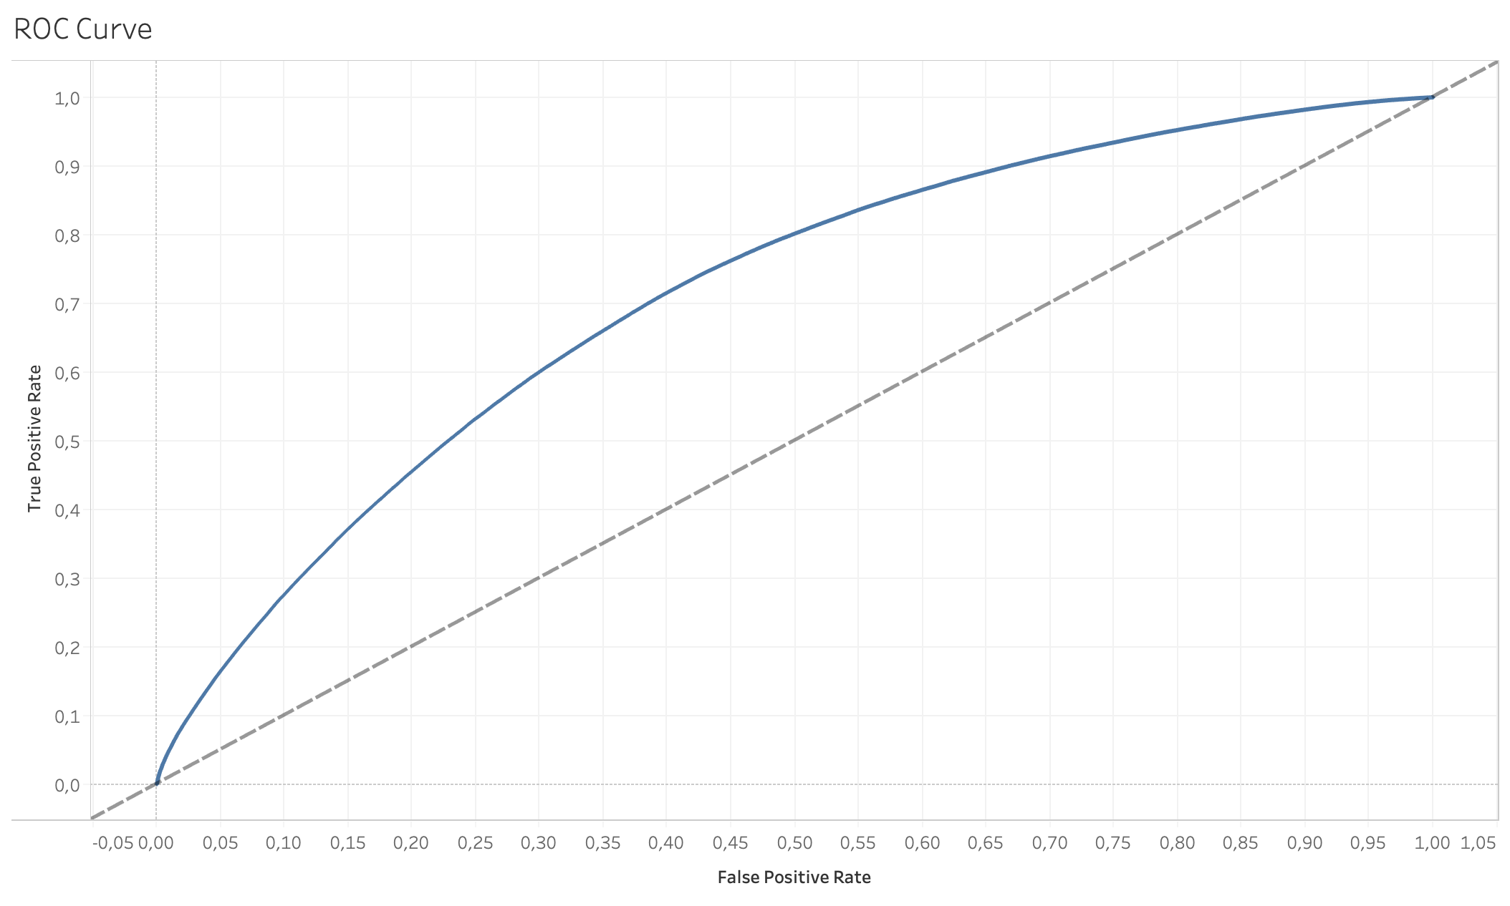
Appendix - Light GBM ROC Curve

Slide 14
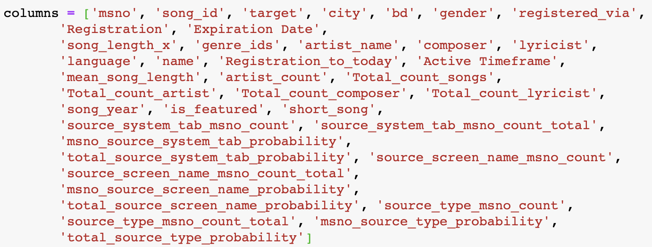
Appendix - Model Features

